Slide 1
CSE 110
Aminul Huq
aminul.huq@bracu.ac.bd

Slide 2
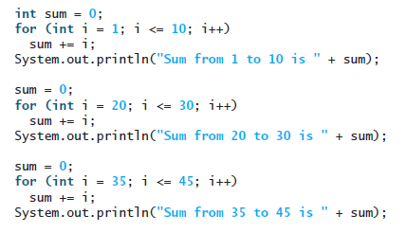
Methods
Suppose that you need to find the sum of integers from 1 to 10, from 20 to 30, and from 35 to 45, respectively. You may write the code as follows:

Slide 3
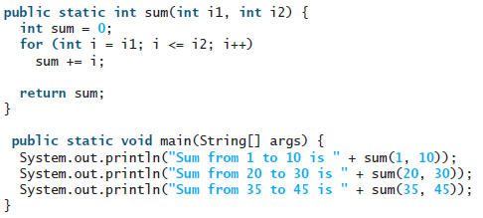
Methods
You may have observed that computing sum from 1 to 10, from 20 to 30, and from 35 to 45 are very similar except that the starting and ending integers are different.
The method is for creating reusable code.

Slide 4

Defining a Method
The syntax for defining a method is as follows:

Slide 5
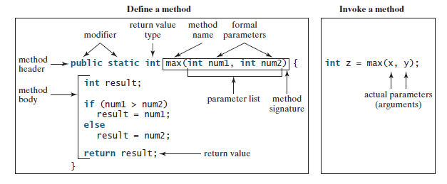
Example
Let’s look at a method created to find which of two integers is bigger. This method, named max, has two int parameters, num1 and num2, the larger of which is returned by the method.

Slide 6
The variables defined in the method header are known as formal parameters or simply parameters. A parameter is like a placeholder. When a method is invoked, you pass a value to the parameter. This value is referred to as an actual parameter or argument.

Slide 7
Calling a Method
In creating a method, you define what the method is to do. To use a method, you have to call or invoke it. There are two ways to call a method, depending on whether the method returns a value or not.
If the method returns a value, a call to the method is usually treated as a value. For example,
int larger = max(3, 4); calls max(3, 4) and assigns the result of the method to the variable larger. Another example of a call that is treated as a value is System.out.println(max(3, 4));
which prints the return value of the method call max(3, 4).

Slide 8
Keep in mind
When a program calls a method, program control is transferred to the called method. A called method returns control to the caller when its return statement is executed or when its method ending closing brace is reached.

Slide 9
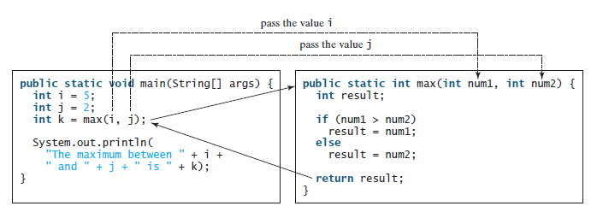

Slide 10

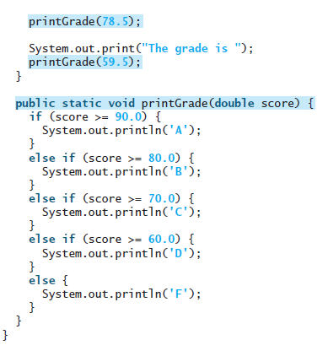

void Method Example

Slide 11
Passing Parameters by Values
The power of a method is its ability to work with parameters. You can use println to print any string and max to find the maximum between any two int values. When calling a method, you need to provide arguments, which must be given in the same order as their respective parameters in the method signature. This is known as parameter order association.

Slide 12
Passing Parameters by Values
When you invoke a method with a parameter, the value of the argument is passed to the parameter. This is referred to as pass-by-value. If the argument is a variable rather than a literal value, the value of the variable is passed to the parameter. The variable is not affected, regardless of the changes made to the parameter inside the method.

Slide 13
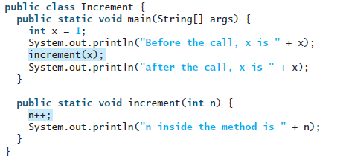

Passing Parameters by Values
The value of x (1) is passed to the parameter n to invoke the increment method (line 5). n is incremented by 1 in the method (line 10), but x is not changed no matter what the method does.

Slide 14
